Slide 1
First 5
Insert brackets to make this true:
9 + 7 × 2 – 12 ÷ 4 = 20
90% of $1,400 =
2 m² = _________ cm²
A cube has a volume of 196 m³ , what is its side length ?
900 g = _________ kg

Slide 2
First 5 Answers
Insert brackets to make this true:
9 + (7 × 2) – (12 ÷ 4) = 20
90% of $1,400 = $1,260
2 m² = ____ 20,000 cm²
A cube has a volume of 196 m³ , what is its side length ? 14 m
900 g = _____ 0.9 kg

Slide 3
Topic: metric units of mass EQ: How to estimate mass?
Year 11 Essentials

Slide 4
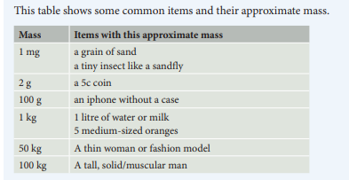
24
7
30
Topic: Measurement
EQ: How to estimate mass ?
What are the weights of some typical objects?

Slide 5
24
7
30
Topic: Measurement
EQ: How to estimate mass ?
What are the weights of some typical objects?
Activity: with partner, come up with some other things that have the mass in the table:
Mass | Items with this approximate mass | Your examples
1 mg | A grain of sand A tiny insect
2 g | A 5c coin
100 g | An Iphone without a case
1 kg | 1 litre of water or milk 5 medium-sized oranges
50 kg | A fashion model
100 kg | A solid, muscular dude
1 t | A small car

Slide 6
24
7
30
Topic: Measurement
EQ: How to estimate mass ?
How to estimate using water?
Milk has a very similar density (mass per volume) to water. The human body also have a density that is similar to water.
Female Babies weigh around 3.2 kg, at six months they weigh 7.3 kg, at 1 year 9kg, and at 2 years they weigh around 11.5 kg. Use these numbers to roughly calculate the size of a baby to a 2L bottle of milk, and complete the table.
Age | Weight (kg) | Estimated volume (cm³ or L) | How many 2L bottles of milk is this?
Birth
6 months
1 year
2 years

Slide 7
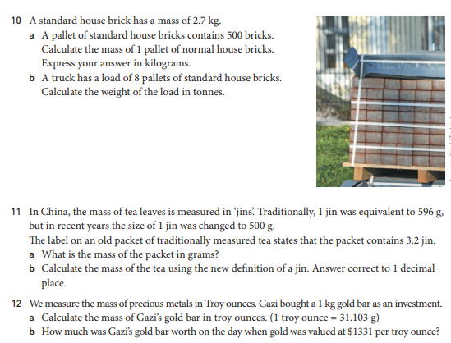
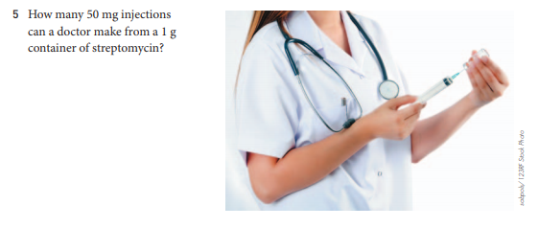

Slide 8

Thank you
Keep up the good work!

